Slide 1
Foundations of Cryptography MAC, EUF-CMA, PRF-based MAC, arbitrary-length MAC, CBC-MAC
LiangFeng Zhang
zhanglf@shanghaitech.edu.cn

Slide 2


Message Integrity
$$Alice$$
Transfer $1000 from Alice’s account to Bob’s
Questions that will be asked by the bank:
Is the message really from Alice? Has the message been modified?
Message Integrity:
ensure the authenticity of messages
prevent undetected tampering of messages
unauthorized modifications can be detected
Encryptions cannot provide message integrity:
Encryption can prevent unauthorized access of the messages

Slide 3
Encryption $⇏$ Integrity
One-Time Pad: $Enc\left(k,m\right)=k⊕m$
Attack: flip a bit of $Enc\left(k,m\right)$
the same bit (location) of $m$ will be flipped, without being detected
PRG-based Encryption Scheme: $Enc\left(k,m\right)=G\left(k\right)⊕m$ ($G$ is a PRG)
Attack: flip a bit of $Enc\left(k,m\right)$
the same bit (location) of $m$ will be flipped, without being detected
The same attack is applicable to stream ciphers
PRF-based Encryption Scheme: $Enc\left(k,m\right)=\left(r,F_{k}\left(r\right)⊕m\right)=(c_{1},c_{2})$
Attack: flip a bit of $c_{2}$
the same bit (location) of $m$ will be flipped, without being detected

Slide 4
Encryption $⇏$ Integrity
OFB: $F$ is a block cipher with block length $n$
$$IV$$
$$F_{k}$$
$$F_{k}$$
$$F_{k}$$
$$m_{1}$$
$$⨁$$
$$m_{2}$$
$$⨁$$
$$m_{3}$$
$$⨁$$
$$IV$$
$$c_{1}$$
$$c_{2}$$
$$c_{3}$$
Attack: flip a bit of any of ciphertext blocks $c_{1},c_{2},c_{3}$
the same bit (location) of the message will be flipped, without being detected

Slide 5
Encryption $⇏$ Integrity
CTR: $F$ is a block cipher with block length $n$
$$ctr$$
$$ctr+1$$
$$ctr+2$$
$$ctr+3$$
$$F_{k}$$
$$F_{k}$$
$$F_{k}$$
$$m_{1}$$
$$⨁$$
$$m_{2}$$
$$⨁$$
$$m_{3}$$
$$⨁$$
$$ctr$$
$$c_{1}$$
$$c_{2}$$
$$c_{3}$$
Attack: flip a bit of any of ciphertext blocks $c_{1},c_{2},c_{3}$
the same bit (location) of the message will be flipped, without being detected

Slide 6
Encryption $⇏$ Integrity
CBC: $F$ is a block cipher with block length $n$
$$m_{1}$$
$$m_{2}$$
$$m_{3}$$
$$IV$$
$$⨁$$
$$⨁$$
$$⨁$$
$$F_{k}$$
$$F_{k}$$
$$F_{k}$$
$$IV$$
$$c_{1}$$
$$c_{2}$$
$$c_{3}$$
Attack: flip a bit of the initial vector $IV$
The same bit (location) of $m_{1}$ will be flipped, without being detected

Slide 7
Encryption $⇏$ Integrity
ECB: $F$ is a block cipher with block length $n$
$$m_{1}$$
$$m_{2}$$
$$m_{3}$$
$$F_{k}$$
$$F_{k}$$
$$F_{k}$$
$$c_{1}$$
$$c_{2}$$
$$c_{3}$$
Attacks: Change the order of ciphertext blocks: $c_{1}c_{2}c_{3}→c_{3}c_{2}c_{1}$
decryption: $c_{3}c_{2}c_{1}→m_{3}m_{2}m_{1}$
The message blocks will be reordered, without being detected

Slide 9

Message Authentication Code
Objective: ensures message integrity in the following sense
Detect unauthorized modification of a message
Detect unauthorized injection of a message
DEFINITION: A message authentication code (MAC) is a tuple
$(Gen, Mac,Vrfy)$ of three PPT algorithms, where
$k←Gen\left(1^{n}\right)$: key-generation, $\left|k\right|≥n$
$t←Mac(k,m)$: tag-generation, $m∈{\left\{0,1\right\}}^{∗}$
$\left\{0,1\right\}←Vrfy(k,m,t)$: verification
Correctness: $Vrfy\left(k,m,Mac\left(k,m\right)\right)=1$
message $m$
tag $t$
$$k$$
$$k$$

Slide 10
Security
Idea: learn $t=Mac(k,m)$ for $m$ should be hard if $k$ is unknown and $t$ not observed
$Mac\left(k,⋅\right):$ for any input $m∈{\left\{0,1\right\}}^{∗}$, output $t=Mac(k,m)$
The message authentication experiment: $Mac$-$forge_{𝒜,Π}(n)$
$$k←Gen\left(1^{n}\right)$$
$$oracle access to$$
$$Mac(k,⋅)$$
$$Challenger$$
$$Adversary 𝒜$$
$$(m,t)$$
$$Mac\text{−}forge_{𝒜,Π}\left(n\right)=1 iff$$
$Vrfy\left(k,m,t\right)=1$
$m∉Q$
$Q:$ the set of messages queried by $𝒜$

Slide 11
Security
DEFINITION: $Π$is existentially unforgeable under an adaptive chosen-
message attack (EUF-CMA) if for all PPT adversary $𝒜$ there is a
negligible function $negl(⋅)$ such that
$\operatorname{Pr}\left[Mac\text{−}forge_{𝒜,Π}\left(n\right)=1\right] ≤negl(n)$,
where the probability is taken over the random coins of $𝒜$ and the
random coins used in the experiment.
Replay attack: an adversary may intercept $(m,t)$ and send it again
sequence numbers: need to be synchronized
time-stamp: send $T||m$ instead of $m$

Slide 13
Fixed-Length MAC from PRF
CONSTRUCTION: $Π=(Gen, Mac,Vrfy)$, a fixed length MAC from PRF
$F:{\left\{0,1\right\}}^{n}×{\left\{0,1\right\}}^{n}→{\left\{0,1\right\}}^{n}$, a length-preserving PRF
$k←Gen\left(1^{n}\right)$:
choose $k←{\left\{0,1\right\}}^{n}$ and output $k$
$t←Mac(k,m)$: $m∈{\left\{0,1\right\}}^{n}$
output $t=F_{k}(m)$
applicable to messages of fixed length: fixed-length MAC
$\left\{0,1\right\}←Vrfy(k,m,t)$:
output 1 iff $t=F_{k}(m)$
re-compute and compare: canonical verification

Slide 14
Security
THEOREM: If $F$ is a PRF, then $Π$ is EUF-CMA.
$Π′=(Gen′, Mac′,Vrfy′)$ is equal to $Π$ except $F_{k}$ is replaced with $f←Func_{n}$
We show that for any PPT algorithm $𝒜$
$\left|\operatorname{Pr}\left[Mac\text{−}forge_{𝒜,Π}\left(n\right)=1\right] −\operatorname{Pr}\left[Mac\text{−}forge_{𝒜,Π^{′}}\left(n\right)=1\right] \right|≤negl(n)$
We show that $\operatorname{Pr}\left[Mac\text{−}forge_{𝒜,Π^{′}}\left(n\right)=1\right] =2^{−n}$
Then the theorem follows.
$$𝒪$$
$$𝒟$$
$$𝒜$$
$$m_{i}$$
$$m_{i}, i∈[q]$$
$$t_{i}=𝒪(m_{i})$$
$$t_{i}$$
$$m$$
$$(m,t)$$
$$t′=𝒪(m)$$
$$output 1 iff$$
$m∉\left\{m_{i}\right\}$
$t^{′}=t$

Slide 15
$\operatorname{Pr}\left[𝒟^{F_{k}\left(⋅\right)}=1\right]=\operatorname{Pr}\left[Mac\text{−}forge_{𝒜,Π}\left(n\right)=1\right]$
$\operatorname{Pr}\left[𝒟^{f\left(⋅\right)}=1\right]=\operatorname{Pr}\left[Mac\text{−}forge_{𝒜,Π^{′}}\left(n\right)=1\right]$
$\left|\operatorname{Pr}\left[Mac\text{−}forge_{𝒜,Π}\left(n\right)=1\right] −\operatorname{Pr}\left[Mac\text{−}forge_{𝒜,Π^{′}}\left(n\right)=1\right] \right|$
$=|\operatorname{Pr}\left[𝒟^{F_{k}\left(⋅\right)}=1\right]−\operatorname{Pr}\left[𝒟^{f\left(⋅\right)}=1\right]|$
$≤negl(n)$
$\operatorname{Pr}\left[Mac\text{−}forge_{𝒜,Π^{′}}\left(n\right)=1\right] =2^{−n}$
This is because $m∉\{m_{1},…,m_{q}\}$ and so $f\left(m\right)$ is truly random for $𝒜$
$$f←Func_{n}$$
$$m_{i}, i∈[q]$$
$$t_{i}=f\left(m_{i}\right)$$
$$(m,t)$$
$$output 1 iff$$
$m∉\left\{m_{i}\right\}$
$t=f(m)$
Challenger
$$𝒜$$

Slide 17
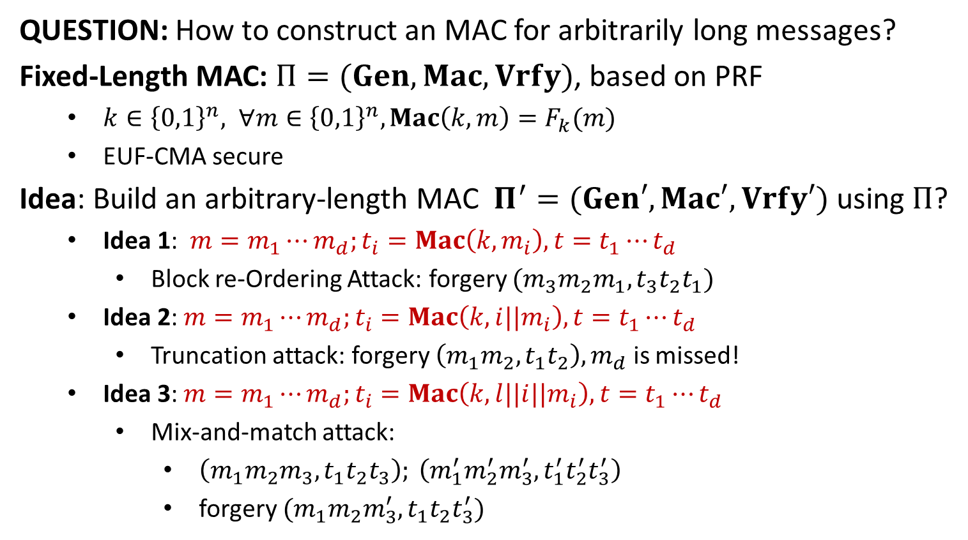
Arbitrary-Length MAC
QUESTION: How to construct an MAC for arbitrarily long messages?
Fixed-Length MAC: $Π=(Gen, Mac,Vrfy)$, based on PRF
$k∈{\left\{0,1\right\}}^{n}, ∀m∈{\left\{0,1\right\}}^{n}, Mac\left(k,m\right)=F_{k}(m)$
EUF-CMA secure
Idea: Build an arbitrary-length MAC $Π^{′}=(Gen′, Mac′,Vrfy′)$ using $Π$?
Idea 1: $m=m_{1}⋯m_{d};t_{i}=Mac\left(k,m_{i}\right), t=t_{1}⋯t_{d}$
Block re-Ordering Attack: forgery $(m_{3}m_{2}m_{1}, t_{3}t_{2}t_{1})$
Idea 2: $m=m_{1}⋯m_{d};t_{i}=Mac\left(k,{i||m}_{i}\right), t=t_{1}⋯t_{d}$
Truncation attack: forgery $\left(m_{1}m_{2},t_{1}t_{2}\right), m_{d}$ is missed!
Idea 3: $m=m_{1}⋯m_{d};t_{i}=Mac\left(k,{l||i||m}_{i}\right), t=t_{1}⋯t_{d}$
Mix-and-match attack:
$\left(m_{1}m_{2}m_{3},t_{1}t_{2}t_{3}\right); \left(m_{1}^{′}m_{2}^{′}m_{3}^{′}, t_{1}^{′}t_{2}^{′}t_{3}^{′}\right)$
forgery $(m_{1}m_{2}m_{3}^{′}, t_{1}t_{2}t_{3}^{′})$

Slide 18
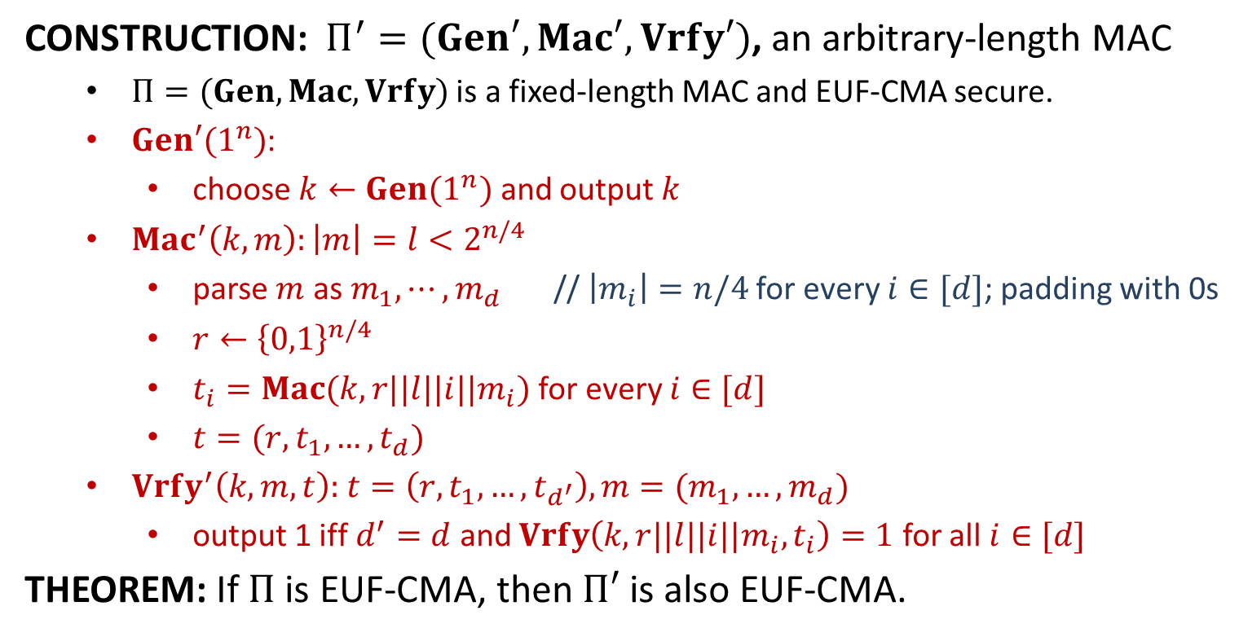
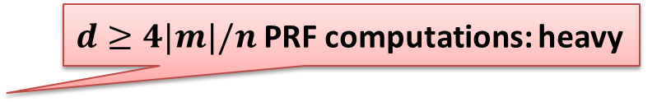
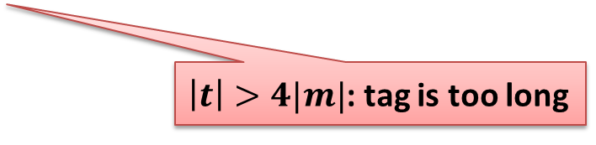
Arbitrary-Length MAC
CONSTRUCTION: $Π^{′}=(Gen′, Mac′,Vrfy′)$, an arbitrary-length MAC
$Π=(Gen, Mac,Vrfy)$ is a fixed-length MAC and EUF-CMA secure.
$Gen′(1^{n})$:
choose $k←Gen(1^{n})$ and output $k$
$Mac^{′}\left(k,m\right):\left|m\right|=l<2^{n/4}$
parse $m$ as $m_{1},⋯,m_{d}$ // $\left|m_{i}\right|=n/4$ for every $i∈[d]$; padding with 0s
$r←{\left\{0,1\right\}}^{n/4}$
$t_{i}=Mac(k,r||l||i||m_{i})$ for every $i∈[d]$
$t=(r,t_{1},…,t_{d})$
$Vrfy^{′}\left(k,m,t\right):$ $t=\left(r,t_{1},…,t_{d^{′}}\right), m=(m_{1},…,m_{d})$
output 1 iff $d^{′}=d$ and $Vrfy\left(k,r||l||i||m_{i}, t_{i}\right)=1$ for all $i∈[d]$
THEOREM: If $Π$ is EUF-CMA, then $Π′$ is also EUF-CMA.
$d≥4|m|/n$ PRF computations: heavy
$\left|t\right|>4|m|$: tag is too long

Slide 20

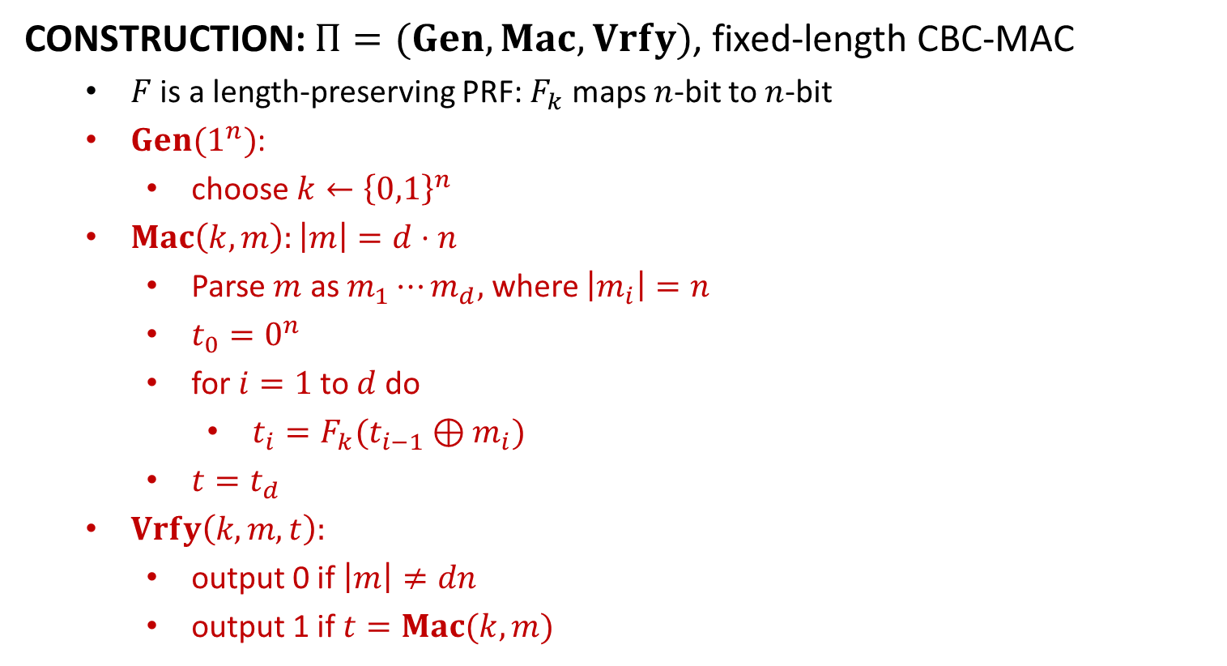







Fixed-Length CBC-MAC
CONSTRUCTION: $Π=(Gen, Mac,Vrfy)$, fixed-length CBC-MAC
$F$ is a length-preserving PRF: $F_{k}$ maps $n$-bit to $n$-bit
$Gen(1^{n})$:
choose $k←{\left\{0,1\right\}}^{n}$
$Mac\left(k,m\right):\left|m\right|=d⋅n$
Parse $m$ as $m_{1}⋯m_{d},$ where $\left|m_{i}\right|=n$
$t_{0}=0^{n}$
for$i=1$to$d$do
$t_{i}=F_{k}(t_{i−1}⊕m_{i})$
$t=t_{d}$
$Vrfy\left(k,m,t\right):$
output 0 if $\left|m\right|≠dn$
output 1 if $t=Mac(k,m)$
$$m_{1}$$
$$m_{2}$$
$$m_{3}$$
$$⨁$$
$$⨁$$
$$F_{k}$$
$$F_{k}$$
$$F_{k}$$
$$t$$

Slide 21
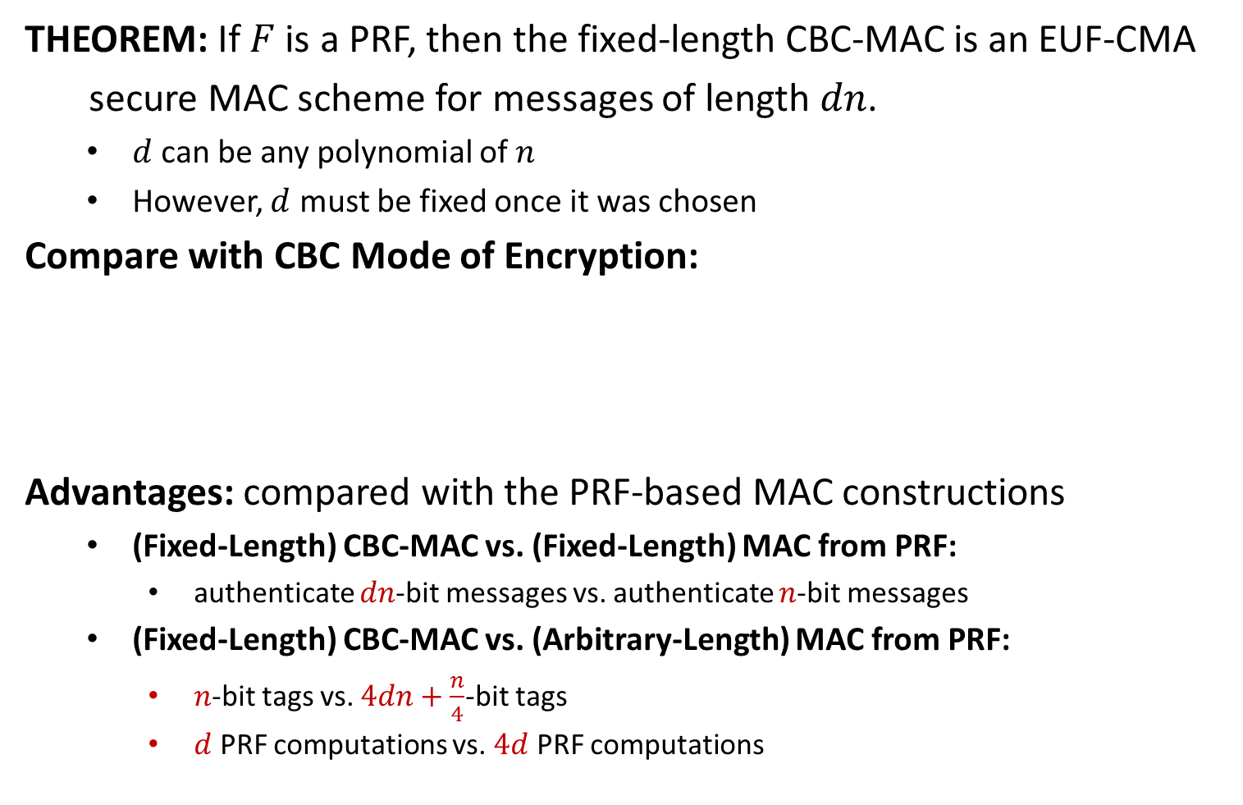
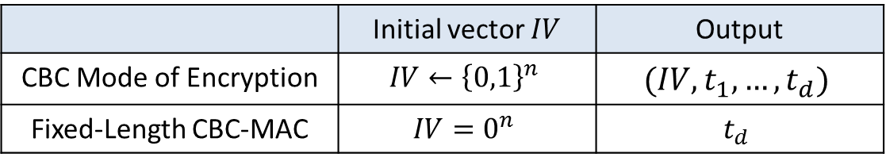
Fixed-Length CBC-MAC
THEOREM: If $F$ is a PRF, then the fixed-length CBC-MAC is an EUF-CMA
secure MAC scheme for messages of length $dn$.
$d$ can be any polynomial of $n$
However, $d$ must be fixed once it was chosen
Compare with CBC Mode of Encryption:
Advantages: compared with the PRF-based MAC constructions
(Fixed-Length) CBC-MAC vs. (Fixed-Length) MAC from PRF:
authenticate $dn$-bit messages vs. authenticate $n$-bit messages
(Fixed-Length) CBC-MAC vs. (Arbitrary-Length) MAC from PRF:
$n$-bit tags vs. $4dn+\frac{n}{4}$-bit tags
$d$ PRF computations vs. $4d$ PRF computations
 | Initial vector $IV$ | Output
CBC Mode of Encryption | $$IV←{\left\{0,1\right\}}^{n}$$ | $$(IV,t_{1},…,t_{d})$$
Fixed-Length CBC-MAC | $$IV=0^{n}$$ | $$t_{d}$$

Slide 22
























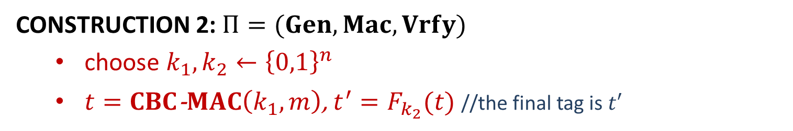
Arbitrary-Length CBC-MAC
CONSTRUCTION 1: $Π=(Gen, Mac,Vrfy)$, arbitrary-length CBC-MAC
prepend $\left|m\right|∈{\left\{0,1\right\}}^{n}$ to $m=m_{1}⋯m_{d}$
$t=CBC$-$MAC(|m|$,$m)$ //CBC-MAC is the fixed-length CBC-MAC
$$|m|$$
$$m_{1}$$
$$m_{2}$$
$$m_{3}$$
$$m_{1}$$
$$m_{2}$$
$$m_{3}$$
$$⨁$$
$$⨁$$
$$⨁$$
$$⨁$$
$$⨁$$
$$F_{k}$$
$$F_{k}$$
$$F_{k}$$
$$F_{k}$$
$$F_{k_{1}}$$
$$F_{k_{1}}$$
$$F_{k_{1}}$$
$$F_{k_{2}}$$
$$t$$
$$t$$
Construction 1
Construction 2
$$t^{′}$$
CONSTRUCTION 2: $Π=(Gen, Mac,Vrfy)$
choose $k_{1}, k_{2}←{\left\{0,1\right\}}^{n}$
$t=CBC$-$MAC\left(k_{1},m\right)$, $t^{′}=F_{k_{2}}(t)$ //the final tag is $t′$

